Slide 1
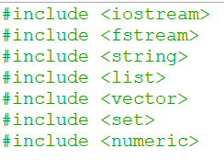
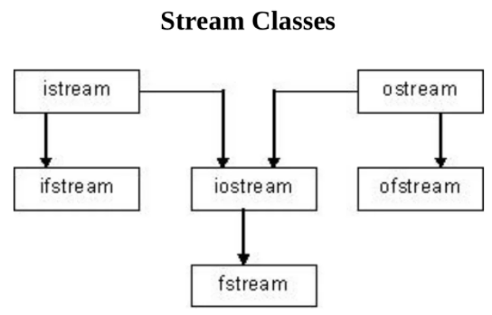
# include <fstream>
ofstream
The output file stream and is used to create files and to write information into file.
ifstream
The input file stream and is used to read information from files.
ios::app
Append mode. All output to that file to be appended (to add on) to the end.
.close
Closes the file currently associated with the object.
.open
Opens the file identified by argument filename.
.is_open
Returns whether the stream is currently associated to a file.

Slide 3
https://app.milanote.com/1NemdJ1jxg2C68?p=TOfIxjtHCSL

Slide 5
Project Objective:
Program with file output operation:
User to enter his/ her car fuel consumption history.
It should include date, amount, brand, odometer reading, etc.
Program with file input operation:
Retrieve car fuel consumption history. Display all details and calculate average litres per km, etc.

Slide 6
main () function
#include <iostream>
#include <fstream>
#include <string>
#include <list>
#include <vector>
#include <set>
#include <numeric>
using namespace std;
void getInput();
void summaryReport();
int count;
//char date[20], fuel[10], odo_reading[10], brand[10];
int main()
{

Slide 7
main () function
int main()
{
ofstream outfile;
outfile.open("Test.txt");
char opt;
// to check 'record' or 'view'
cout <<"\nNOTE : [R] = record car fuel consumption history ; [V] = view car fuel comsumption report " ;
cout << "\nPlease Input [R] / [V] ? : ";
cin >> opt;
cin.ignore();
if ((opt == 'R') || (opt == 'r'))
{
getInput();
}
else if ((opt == 'V') || (opt == 'v'))
{
cout << "\nNo data found. Please input new data. " << endl;
getInput();
}
outfile.close();
return 0;
}
User:
to choose which option [opt]:
View or Record fuel consumption
input option of choice.
if option: R/r - program will run: get input (); function.
if option: V/v - program will output "No data found. Please input new data"
if no data input found: - program will run get input () function to create the data

Slide 8
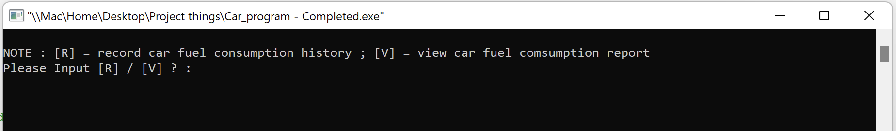
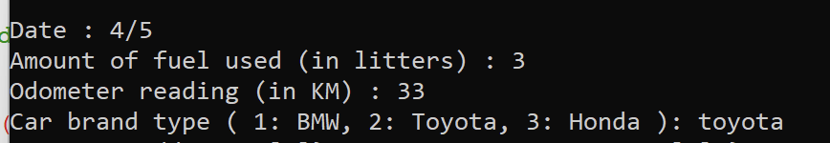
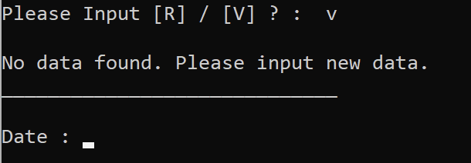
main () function
int main()
{
ofstream outfile;
outfile.open("Test.txt");
char opt;
// to check 'record' or 'view'
cout <<"\nNOTE : [R] = record car fuel consumption history ; [V] = view car fuel comsumption report " ;
cout << "\nPlease Input [R] / [V] ? : ";
cin >> opt;
cin.ignore();
if ((opt == 'R') || (opt == 'r'))
{
getInput();
}
else if ((opt == 'V') || (opt == 'v'))
{
cout << "\nNo data found. Please input new data. " << endl;
getInput();
}
outfile.close();
return 0;
}
if option: R/r - program will run: get input (); function.
if option: V/v - if user have yet to input record - program will output "No data found.” and run get input (); function to gather data first.

Slide 9
main () function
int main()
{
ofstream outfile;
outfile.open("Test.txt");
char opt;
// to check 'record' or 'view'
cout <<"\nNOTE : [R] = record car fuel consumption history ; [V] = view car fuel comsumption report " ;
cout << "\nPlease Input [R] / [V] ? : ";
cin >> opt;
cin.ignore();
if ((opt == 'R') || (opt == 'r'))
{
getInput();
}
else if ((opt == 'V') || (opt == 'v'))
{
cout << "\nNo data found. Please input new data. " << endl;
getInput();
}
outfile.close();
return 0;
}
ofstream outfile;
outfile.open("Test.txt");
outfile.close();

Slide 10
void getInput() function
void getInput()
{
char date[20], fuel[10], odo_reading[10], brand[10];
char opt;
cout << "_____________________________\n" << endl;
cout << "Date : ";
cin.getline(date, 20);
cout << "Amount of fuel used (in litters) : ";
cin.getline(fuel, 10);
cout << "Odometer reading (in KM) : ";
cin.getline(odo_reading, 10);
cout << "Car brand type ( 1: BMW, 2: Toyota, 3: Honda ): ";
cin.getline(brand, 10);
// using <string> class to create an array of mutable strings :
// the size of the string is not fixed, and the strings can be changed.
string car_Fuel_Consumption_Record[4] = {date, fuel, odo_reading, brand};
Display instruction & get input from user for each array:
date
fuel
odo_reading
car brand

Slide 11
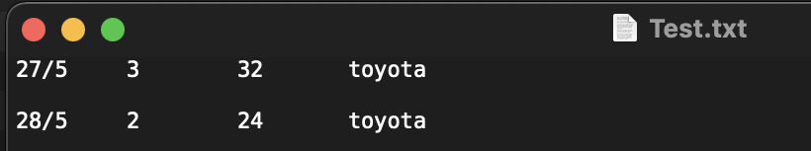
void getInput() function
Collect data one time.
ofstream outfile;
outfile.open("Test.txt", ios::app); //append
if (outfile.is_open())
{
for (int i = 0; i < 4; i++)
{
// transport the data that has being stored in the string array into the txt file
// seperate each value by a delimiter (in this case : a tab)
outfile << car_Fuel_Consumption_Record[i] << "\t" ;
count++;
}
outfile << "\n" << endl;
outfile.close();
}
else
{
cout << "Unable to open file. ";
}
Open Test.txt file, append
if File is open >> will run for loop
transport the data that has being stored in the string array into the txt file
seperate each value by a delimiter (in this case : a tab)
outfile << "\n" << endl;
if file not open, for loop will cout "Unable to open file."

Slide 12
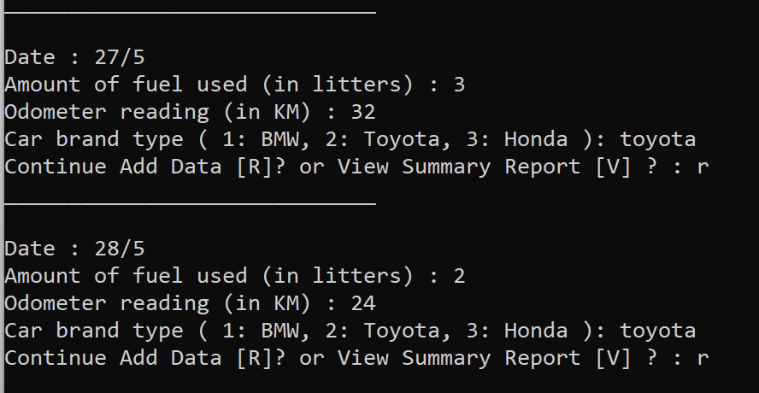
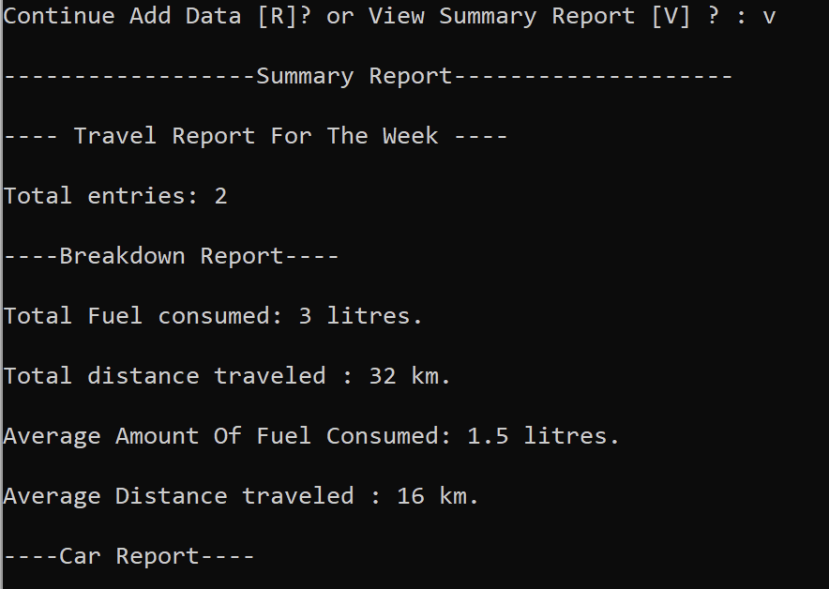
void getInput() function
cout << "Continue Add Data [R]? or View Summary Report [V] ? : ";
cin >> opt;
cin.ignore();
if ((opt == 'R') || (opt == 'r'))
{
return getInput();
}
else
{
summaryReport();
}
}
Add data or change option
if else statement for user to choose whether to:
add more data
or view summary report instead.
program will run summaryReport() function.
Opt: R
Opt: V

Slide 13
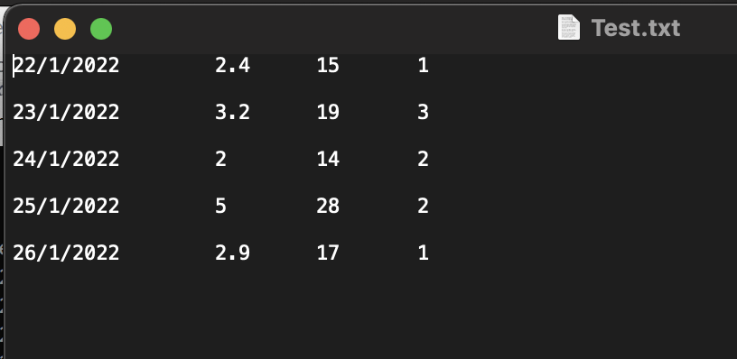
void summaryReport () function
void summaryReport ()
{
cout << "\n------------------Summary Report--------------------\n\n";
ifstream inFile;
inFile.open("Test.txt");
if (inFile.fail())
{
cerr << "Error opening file. " << endl;
exit(1);
}
else
{
// Retrive car_brand_set information
ifstream infile("Test.txt");
iftream : Stream class to read from files
Create an instance of ofstream name "inFile"
Open the file. (Check for failure to open.)
if statement - if fail to open the file .. Program will output "Error opening file. ".
else statement - open "test.txt" file

Slide 14
void summaryReport () function
string date[20];
double fuel[10], odo_reading[10];
int brand[10];
double fuel_Total = 0;
double fuel_Avg = 0;
double odometer_Total = 0;
double odometer_Avg = 0;
double distance = 0;
double a_fuel = 0;
double b_fuel = 0;
double c_fuel = 0;
double a_km = 0;
double b_km = 0;
double c_km = 0;
double a_avg_fuel = 0;
double b_avg_fuel = 0;
double c_avg_fuel = 0;
int x = count / 4;
int i, a = 0, b = 0, c = 0;
cout << "---- Travel Report For The Week ----" << endl;
cout << endl << "Total entries: " << x << endl;
Declare array & initialise variables

Slide 15
void summaryReport () function
int x = count / 4;
int i, a = 0, b = 0, c = 0;
cout << "---- Travel Report For The Week ----" << endl;
cout << endl << "Total entries: " << x << endl;
for(i = 0; i < x; i++)
{
infile >> date[i] >> fuel[i] >> odo_reading[i] >> brand[i];
}
For loop
1st : read file and get value from each row.

Slide 16
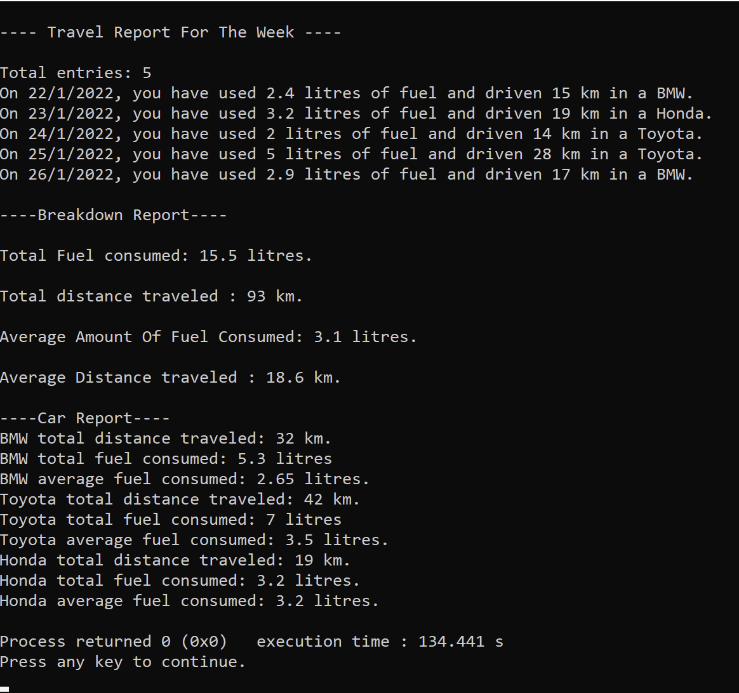
for(i = 0; i < x; i++)
{
if (brand[i] == 1)
{
cout << "On " << date[i] << ", you have used " << fuel[i] << " litres of fuel and driven "
<< odo_reading[i] << " km in a BMW." << endl;
a++;
a_fuel += fuel[i];
a_km += odo_reading[i];
a_avg_fuel = a_fuel / a;
}
if (brand[i] == 2)
{
cout << "On " << date[i] << ", you have used " << fuel[i] << " litres of fuel and driven "
<< odo_reading[i] << " km in a Toyota." << endl;
b++;
b_fuel += fuel[i];
b_km += odo_reading[i];
b_avg_fuel = b_fuel / b;
}
if (brand[i] == 3)
{
cout << "On " << date[i] << ", you have used " << fuel[i] << " litres of fuel and driven "
<< odo_reading[i] << " km in a Honda." << endl;
c++;
c_fuel += fuel[i];
c_km += odo_reading[i];
c_avg_fuel = c_fuel / c;
}
}
void summaryReport () function
For loop:
2nd: display all the output according to brand of car

Slide 17
void summaryReport () function
// Fuel Total
for (int i = 0; i < x; i++)
{
fuel_Total += fuel[i];
}
// Fuel Average
fuel_Avg = fuel_Total / x;
// Odometer Total
for (int i = 0; i < x; i++)
{
odometer_Total += odo_reading[i];
}
// Odometer average
odometer_Avg = odometer_Total / x;
//For calculating the average km and fuel per car
for (int i = 0; i < x; i++)
{
}
For loops
Calculating total then average for both fuel & odometer

Slide 18
void summaryReport () function
cout << "\n----Breakdown Report----\n";
cout << "\nTotal Fuel consumed: " << fuel_Total << " litres."<< endl;
cout << "\nTotal distance traveled : " << odometer_Total << " km." << endl;
cout << "\nAverage Amount Of Fuel Consumed: " << fuel_Avg << " litres." << endl;
cout << "\nAverage Distance traveled : " << odometer_Avg << " km." << endl;
cout << "\n----Car Report----\n";
if (a > 0)
{
cout << "BMW total distance traveled: " << a_km << " km." << endl;
cout << "BMW total fuel consumed: " << a_fuel << " litres" << endl;
cout << "BMW average fuel consumed: " << a_avg_fuel << " litres." << endl;
}
if (b > 0)
{
cout << "Toyota total distance traveled: " << b_km << " km." << endl;
cout << "Toyota total fuel consumed: " << b_fuel << " litres" << endl;
cout << "Toyota average fuel consumed: " << b_avg_fuel << " litres." << endl;
}
if (c > 0)
{
cout << "Honda total distance traveled: " << c_km << " km." << endl;
cout << "Honda total fuel consumed: " << c_fuel << " litres." << endl;
cout << "Honda average fuel consumed: " << c_avg_fuel << " litres." << endl;
}
}
}
display out breakdown report for:
fuel consumed
distance travelled
average fuel consumed
average distance travelled
then display out according to car brand:
distance travelled
total fuel consumed
average fuel consumed

